Slide 1

P-175- Forecast Gold Prices
PROJECT BY :
1. Mr. Abhishek Devanand Karande
2. Mr. Nihal Mehboob Mulani
3. Mr. Deepak mahtha
4. Mr. Rushil Rajendra Dumbre
5. Mr. Ajinkya Rajendra Bhandarge
6. Mr. Abhineeth HR

Slide 2

Contents
Business Objective
Data Collection & Details
Exploratory Data Analysis
Visualizations
Modeling
Evaluation
Deployment

Slide 3
Business Objective :
Data provided is related to gold prices. The objective is to understand the underlying structure in your dataset and come up with a suitable forecasting model which can effectively forecast gold prices for next 30 days.
This forecast model will be used by gold exporting and gold importing companies to understand the metal price movements and accordingly set their revenue expectations.

Slide 4
Significance of GOLD :
GOLD
Global Currency
Investment Tool
Hedging against inflation
Stable
Commodity

Slide 5
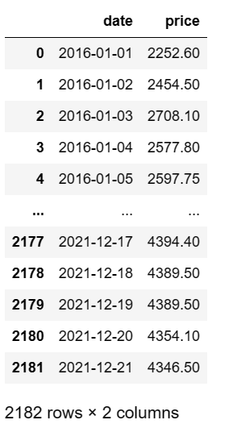
Data Collection & Details
2182 rows & 2 column
Year range 01-01-2016 to 21-12-2021
Unique Date 2182 and Price 1876
These are the explanations for variables.
1) Date (object) : Daily entry date
2) Price (Float64) : Gold Price

Slide 6
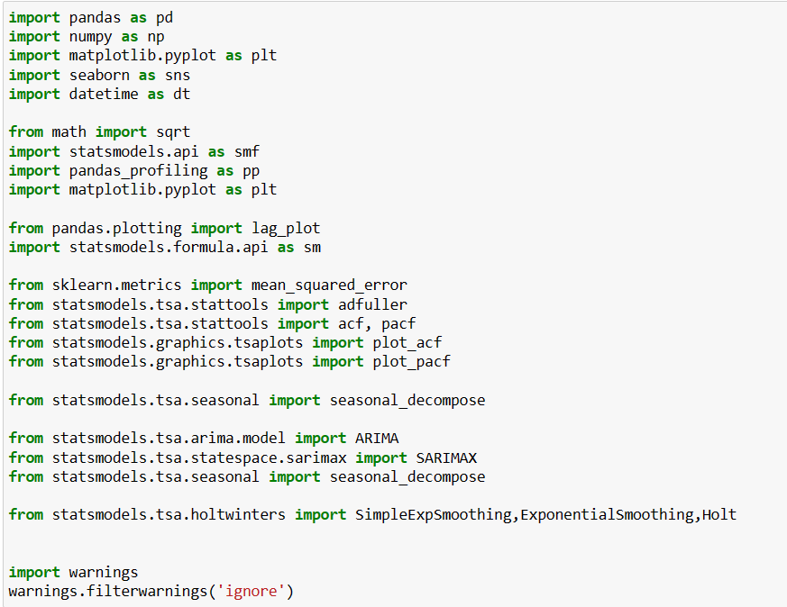
Importing Libraries

Slide 7

Exploratory Data Analysis (EDA)

Slide 8
Exploratory Data Analysis
In Time Series Analysis we will analyze to find out the below stuff
Missing values
Duplicated values
Outlier Detection
Feature Scaling
Feature Extraction
Correlation
Skewness Removal
Data Insights
Stationarity Test
Autocorrelation Function
Partial Autocorrelation Function
Lag plots
Normal Distribution Analysis
Relationship between independent and dependent feature (Price and date)

Slide 9
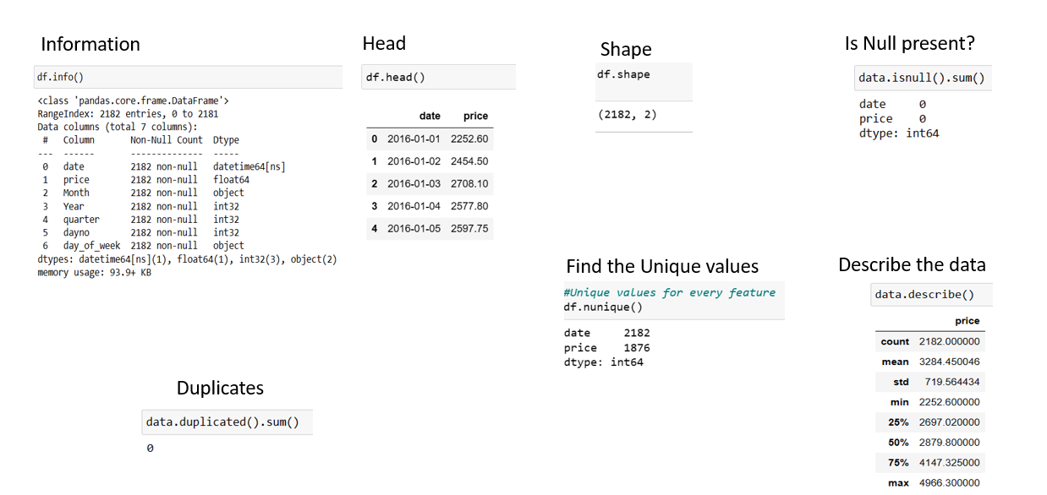

Slide 10
Descriptive Analysis :
- As we can see, in the dataset the minimum gold price is 2252 and maximum is double i.e. 4966.
- Average price is 3284.
- The diff between maximum and 75% is not out of bound hence we can say that there is no outlier present in the dataset.

Slide 11
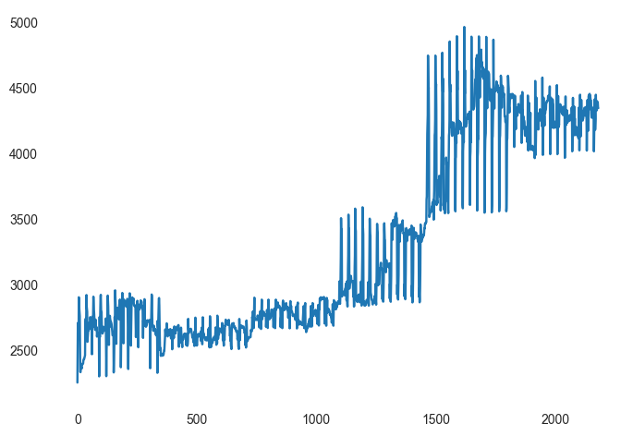
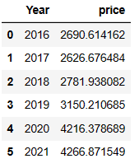
Univariate Analysis :
Histogram Plot
From the above we can say that the highest Gold price on thw 8th Jun 2020 and the lowest price on the 1st April 2016.
Here we can see the average of every year

Slide 12
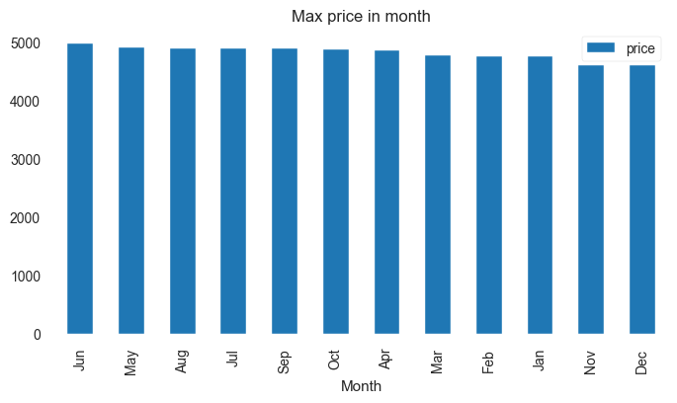
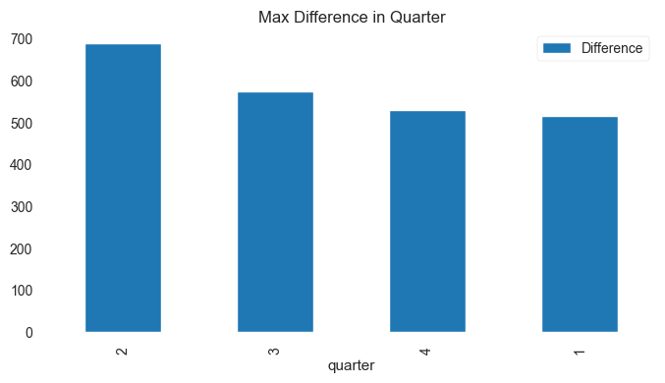
Max price in month
Max difference in quarter

Slide 13
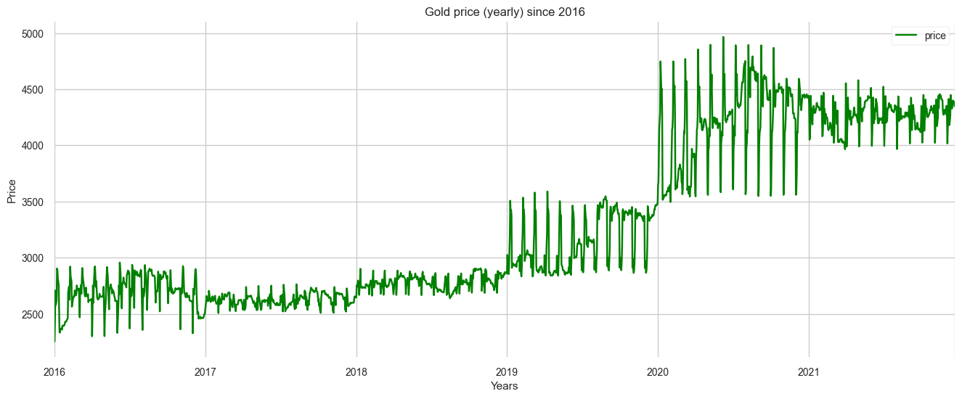
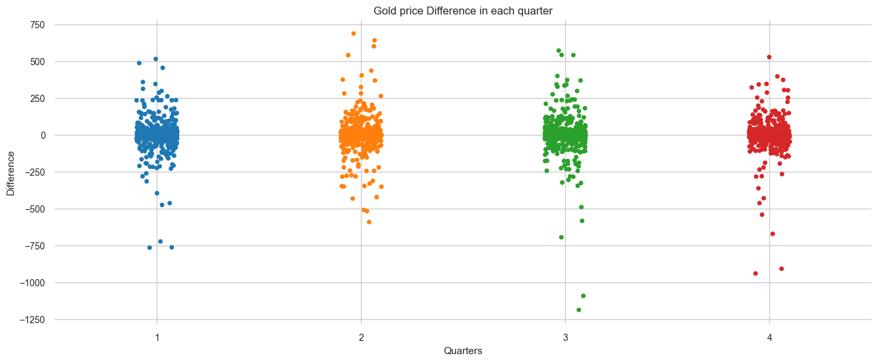
Gold price yearly since 2016 :
Gold price difference in each quarter :

Slide 14
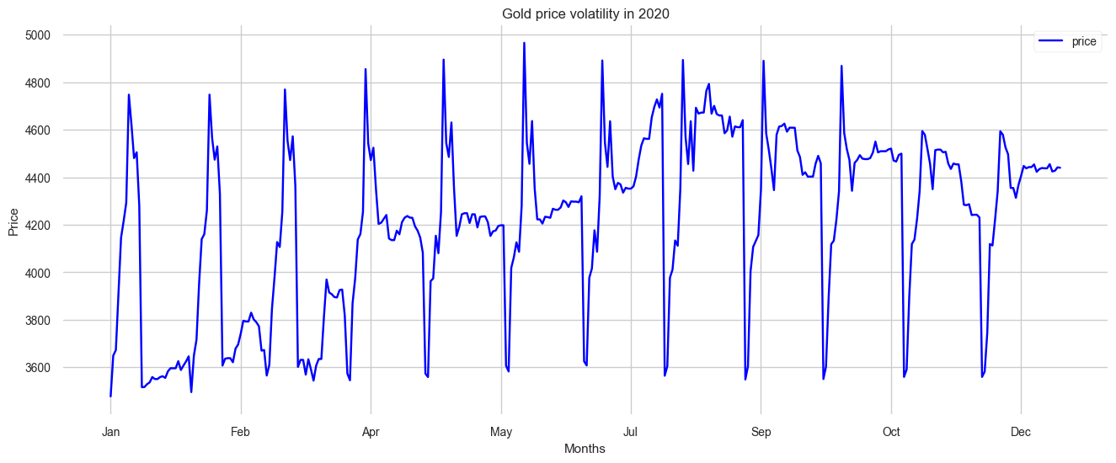
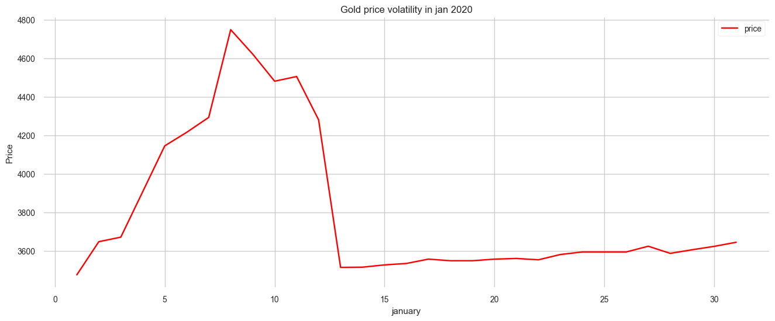
For 2020 year :
For 2020 January month :

Slide 15
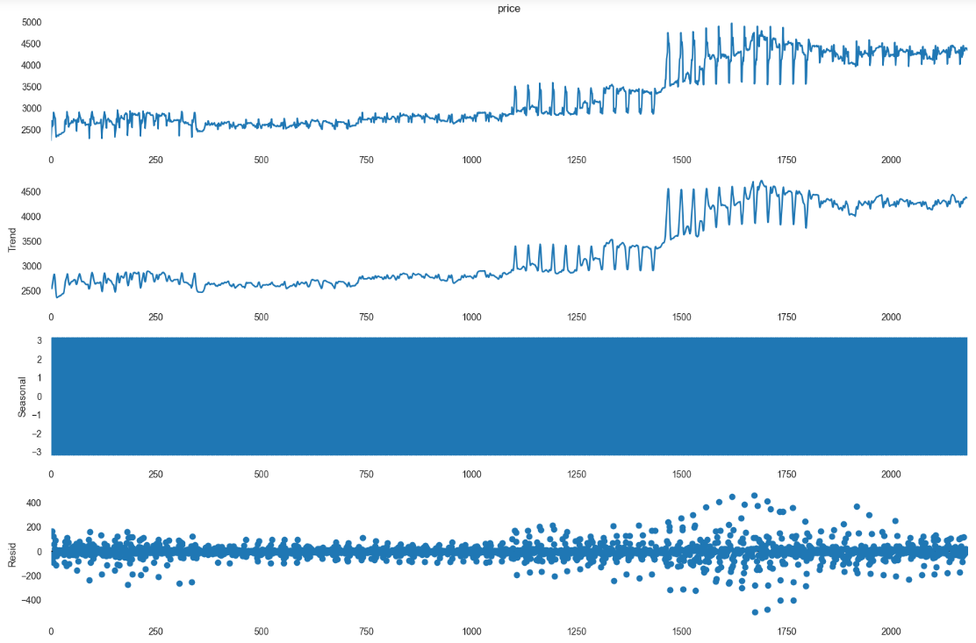
Time Series Decomposition
Trend - Increasing or decreasing trend.
Seasonal - Varies from +0.5 to -0.5 with the mean 0. Each cycle represents each year
trend. The value in the Y-axis has to be
added to the Trend plot value to get the
actual value of that year. E.g.:- For the year
1988 Nov, the seasonal value is +0.5 and the
trend value is 100. Hence, teh actual
value(passengers number) will (seasonal+Trend)
value = 0.5+100 = 100.5
Residual - It is the noise pattern of the time
series data for each year, which was not
captured by the two components - Trend and
Seasonality. Residual is the left over after
decomposition of the two major components
(Trend and Seasonality)

Slide 16
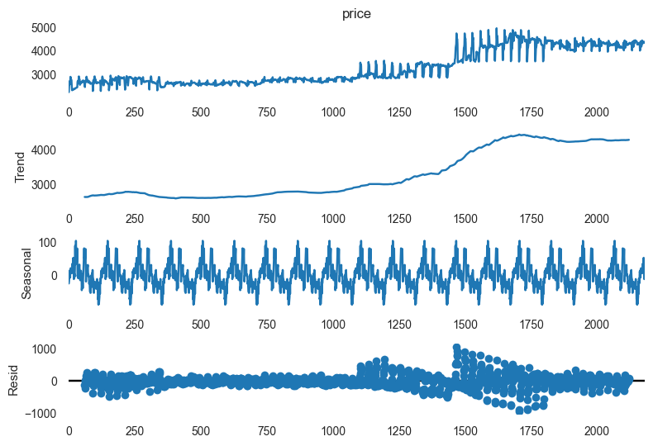
Additive Seasonal Decompose :
Analysis:- Observed - Actual data
Trend - Increasing or decreasing trend.
Seasonal - Varies from +0.5 to -0.5 with the mean 0. Each cycle represents each year trend. The value in the Y-axis has to be added to the Trend plot value to get the actual value of that year. E.g.:- For the year 1988 Nov, the seasonal value is +0.5 and the trend value is 100. Hence, teh actual value(passengers number) will (seasonal+Trend) value = 0.5+100 = 100.5
Residual - It is the noise pattern of the time series data for each year, which was not captured by the two components - Trend and Seasonality. Residual is the left over after decomposition of the two major components (Trend and Seasonality)

Slide 17
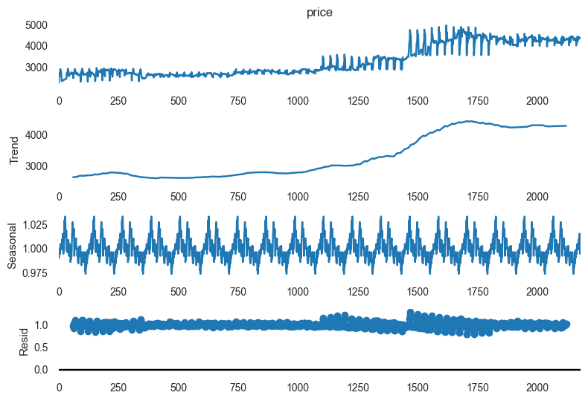
Multiplicative Seasonal Decomposition :

Slide 18
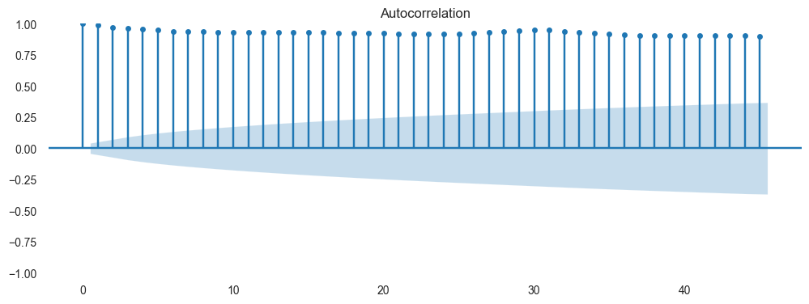
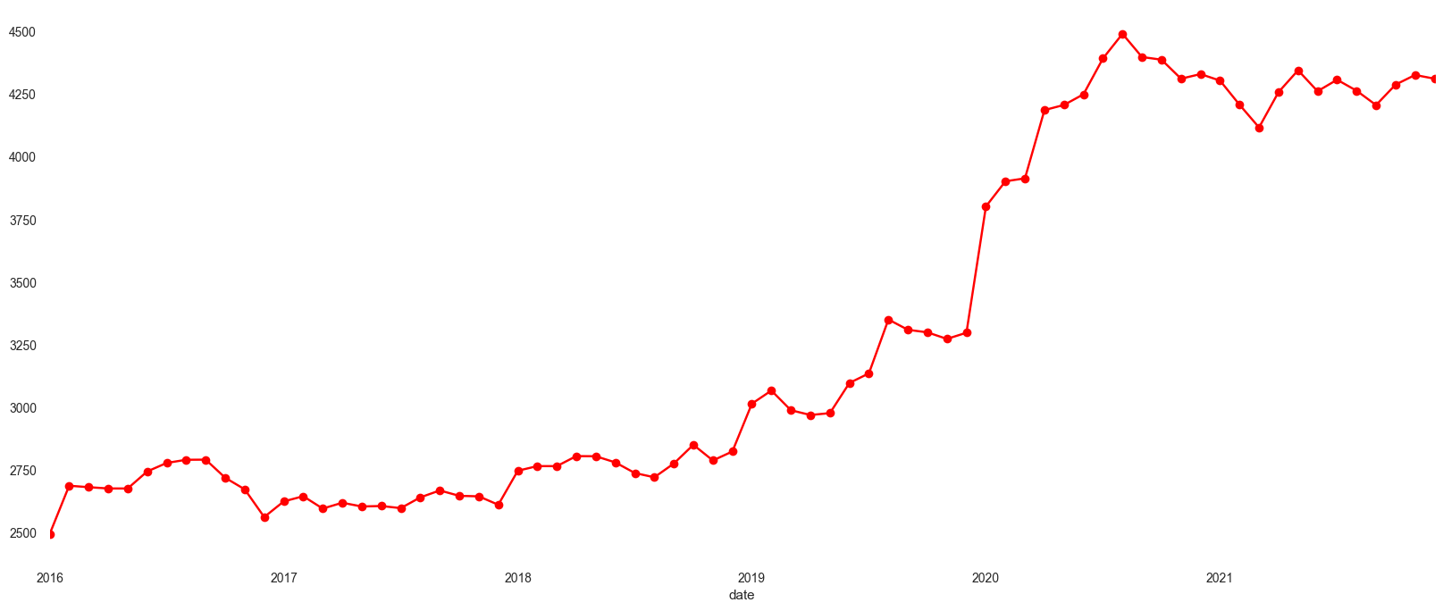
PACF and ACF plot
Month wise yearly Price

Slide 19
Check for Stationary or Non-Stationary Time-series
1)Augmented Dickey-Fuller (ADF) Test
- Null Hypothesis (H0): The series is not stationary
p-val > 0.05
- Alternate Hypothesis (H1): The series is stationary
p-val <= 0.05
Analysis
p-value (0.92) > critical value(0.05).
Failed to reject null hypothesis (The series is not stationary)
Hence, the time series is Non-Stationary.

Slide 20
Kwiatkowski-Phillips-Schmidt-Shin (KPSS) Test
Null Hypothesis (H0): The series is stationary
p-val>0.05
Alternate Hypothesis (H1): The series is not stationary
p-val <= 0.05
Analysis
p-val(0.01) < Critical value(0.05) Reject the null hypothesis (The series is stationary)
Hence, as per alternate hypothesis the time series is non stationary

Slide 21
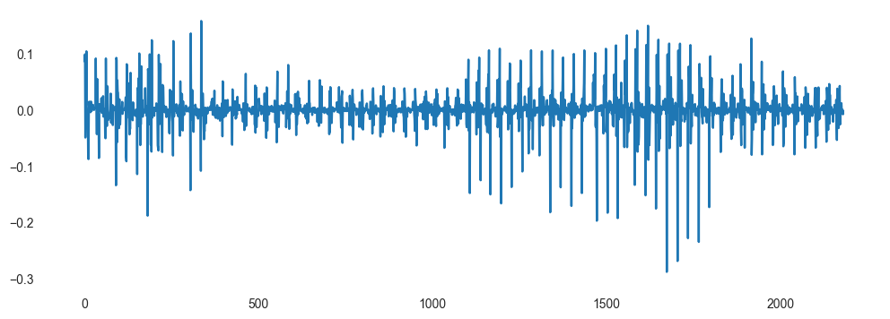
Converting Non-Stationary to Stationary Time Series
To make our Data Stationary We apply Some Methods
Transformation
i) Log Tranformation
ii) Square root Transformation
iii) Log Differencing Method
iv) Square root differencing
i) Log transforming of the data
ADF Test
Analysis:
Test Statistic > Critical Value and
p-value < 0.05.
KPSS TEST
Analysis
Test Statistic > Critical Value and p-value < 0.05.
here looks Reversed 0.020000 < 0.146 and 0.100000 < 0.05
From this we conclude that our data is stationary.

Slide 22
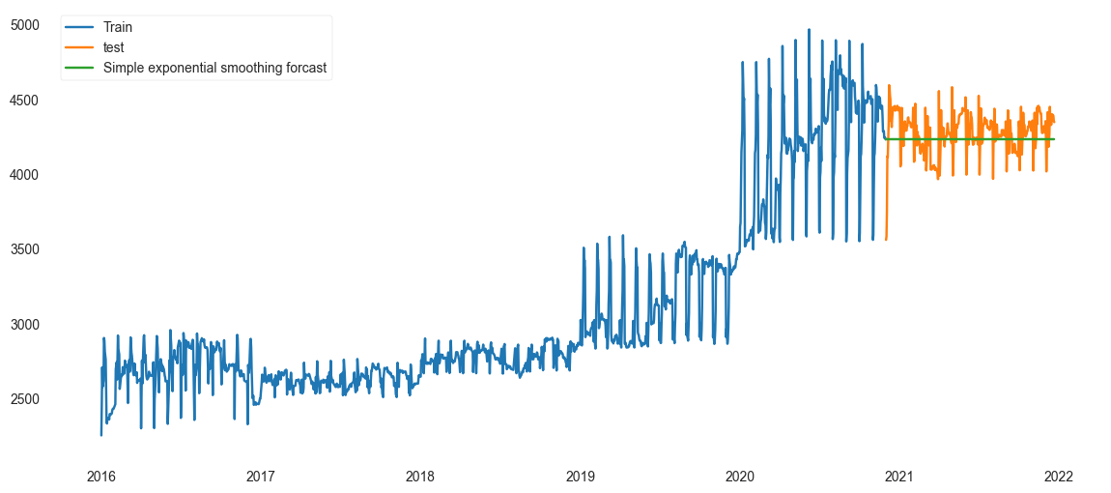

Simple Exponential
Double Exponential

Slide 23
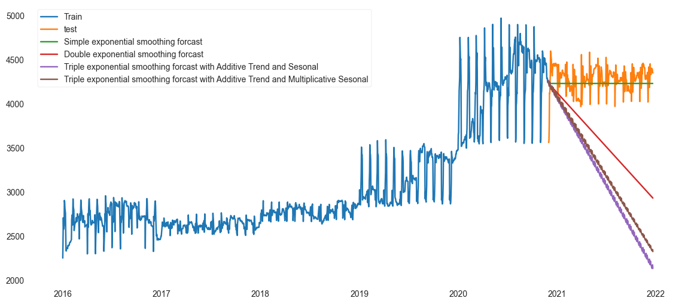
Holts winter exponential smoothing with multiplicative seasonality and additive trend (Triple Exponential)

Slide 24

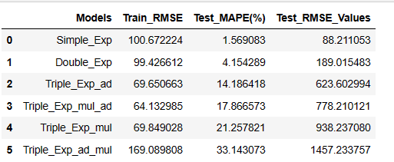
Comparing the results :

Slide 25
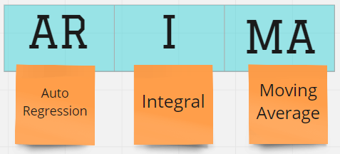
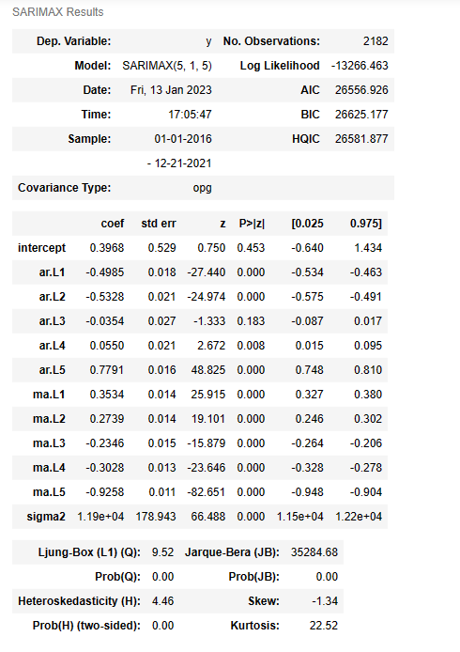
ARIMA MODEL :

Slide 26
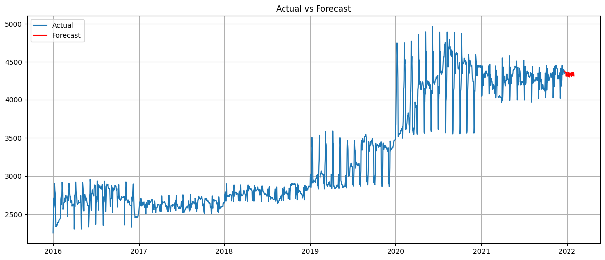
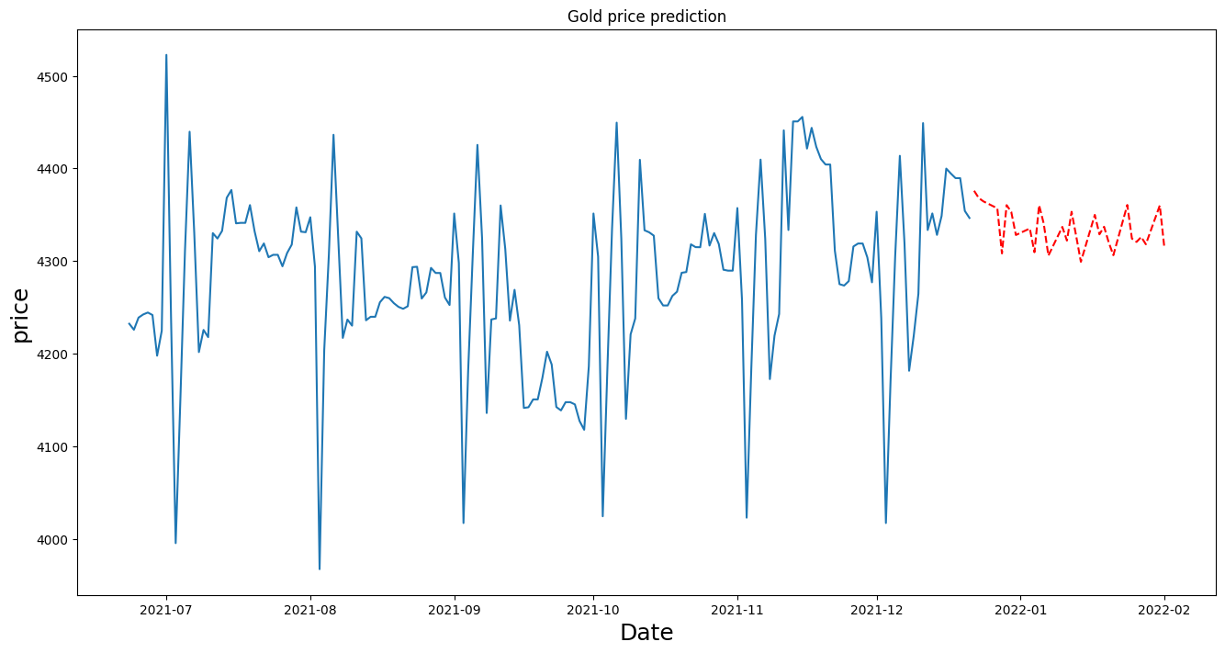

Slide 27

Deployment :

Slide 28
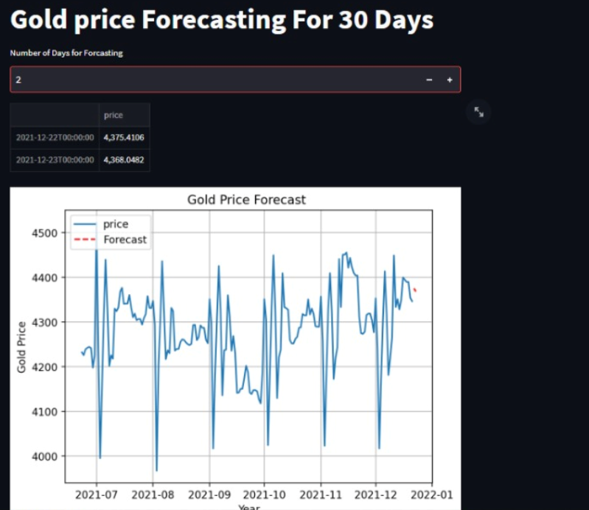
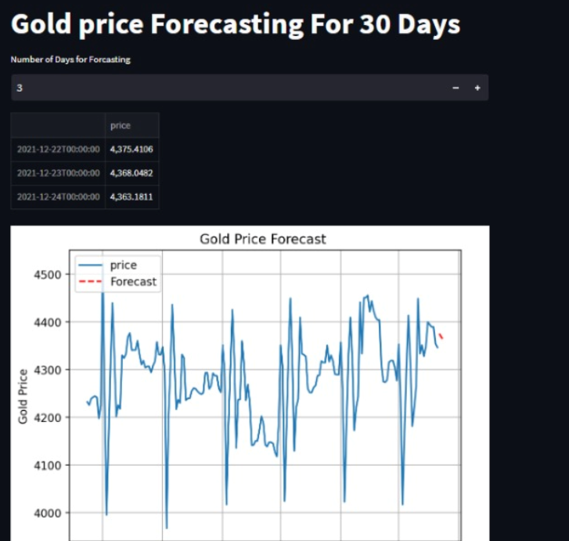
DEPLOYMENT :

Slide 29
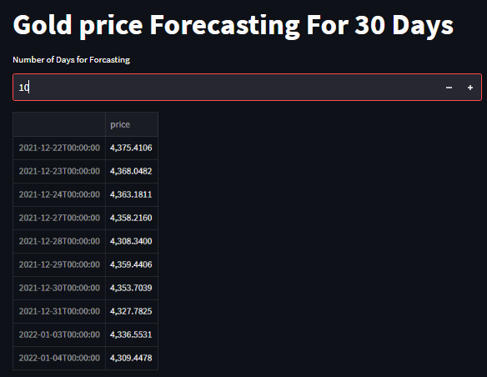
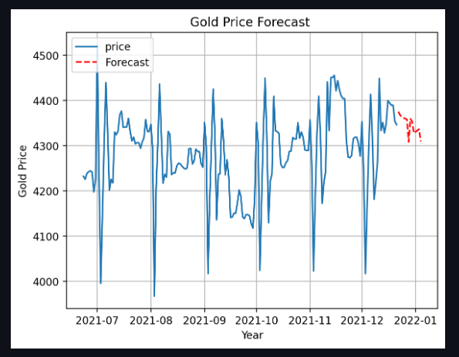

Slide 30

Challenges faced :
Research on history of gold prices
Deciding model building technique

Slide 31
How Challenges Overcome :
We also find the pattern of price volatility in season wise, year wise.
We research on different factors affecting the gold price
We as a team worked so hard to get the knowledge on the previous year gold price data.
Which helps us to do the project more effectively.

Slide 32
Deciding Model Building Technique :
As we tried many model building techniques every model don’t have such a significant difference in the output
We are little bit worried about the output results that we got.
But we again overcame this as a team, Everyone has worked really hard on this part and we finally build a model that best suits the data

Slide 33


